Slide 1
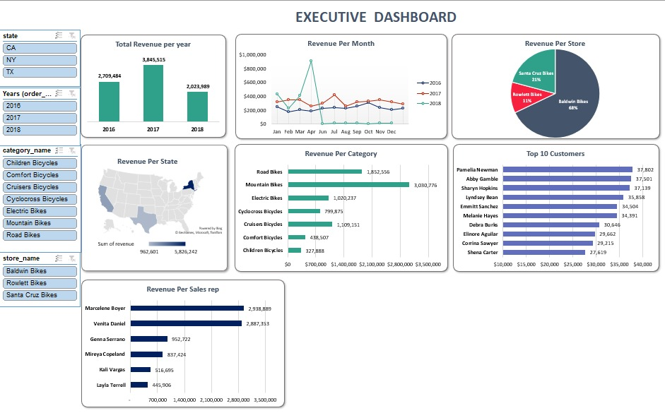
"Maximizing Revenue and Market Performance: Insights and Strategies for Bike Stores"
Welcome to our presentation on Bike Stores' revenue analysis. Today, we'll dive into the data to uncover insights that drive our business forward. We'll explore revenue distribution across categories, states, customers, and sales representatives, revealing key trends and opportunities. By dissecting this data, we'll gain actionable insights to guide strategic decision-making and propel Bike Stores to greater success. Thank you for joining us on this journey of discovery.

Slide 2
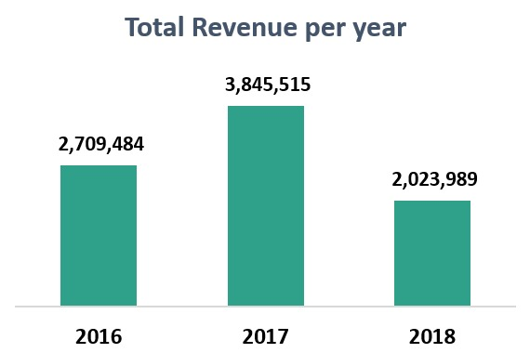
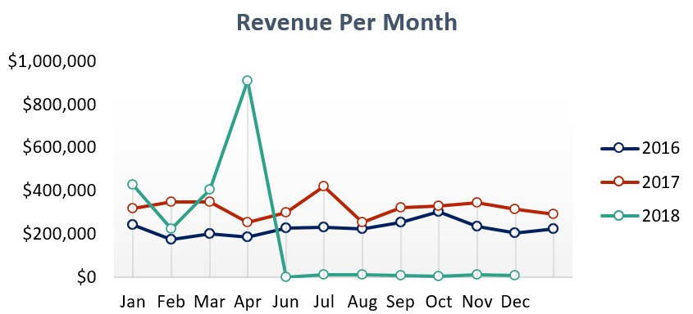
Total Revenue Per Month & Year
In examining Bike Stores' revenue performance from 2016 to 2018, a dynamic narrative unfolds. Commencing with $2,709,484 in 2016, revenue surged to $3,845,515 in 2017, signifying a promising ascent. However, 2018 posed challenges, with revenue declining to $2,023,989, marking a moment of reflection and adaptation.
This journey mirrors the highs and lows of navigating business terrain, showcasing resilience and strategic acumen.
Insights gleaned from these fluctuations empower informed decision-making, enabling Bike Stores to capitalize on growth opportunities and navigate market complexities with clarity and confidence.

Slide 3
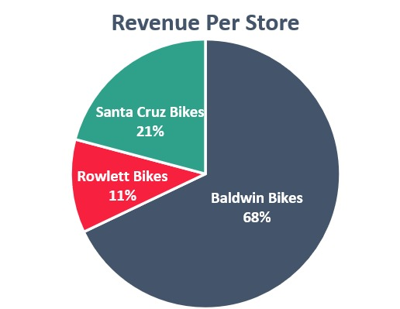
Revenue Per Store
In examining revenue distribution per store, Baldwin Bikes emerges as the top performer, contributing 68% of the total revenue with $5,826,242.
.Rowlett Bikes follows, accounting for 11% of the revenue with $962,600.76 while Santa Cruz Bikes contributes 21% with $1,790,145.
This breakdown underscores the significant contribution of each store to the overall revenue, with Baldwin Bikes playing a dominant role.
Understanding these proportions aids in strategic resource allocation and optimization to further enhance revenue generation across all stores.

Slide 4
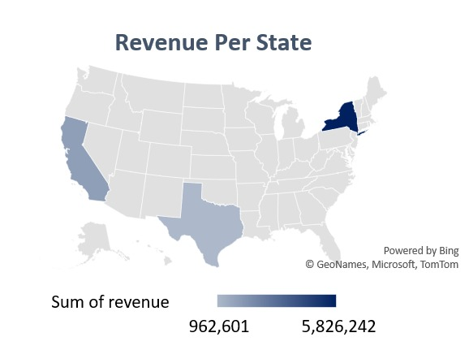
Revenue Per State
Analyzing revenue per state highlights New York (NY) as the dominant contributor, generating $5,826,242 representing 67.91% of the total revenue.
Following, California (CA) contributes $1,790,146 comprising 20.87% of the total, while Texas (TX) accounts for $962,601 making up 11.22%.
This distribution underscores the significance of New York and California in revenue generation, necessitating tailored strategies to capitalize on their market potential.
Understanding these state-specific revenue dynamics is vital for optimizing resource allocation and maximizing profitability across diverse geographical regions.

Slide 5
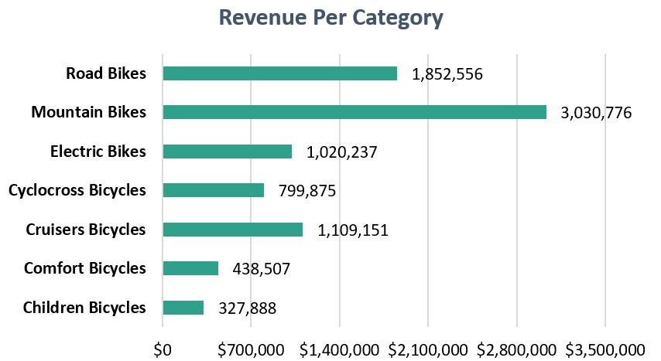
Revenue Per Category
Analyzing revenue per category reveals Mountain Bikes as the top performer, generating $3,030,776 constituting 35.33% of total revenue.
Road Bikes follow closely, contributing $1,852,556 comprising 21.59% of the total.
Additionally, Electric Bikes and Cruisers Bicycles make substantial contributions, with $1,020,237 and $1,109,151 respectively.
Furthermore, Comfort Bicycles and Children Bicycles contribute $438,507 and $327,888 accounting for 5.11% and 3.82% of the total revenue, respectively.
This breakdown illuminates the diverse consumer landscape and guides strategic decisions to optimize product offerings and capitalize on market opportunities across various bicycle categories.

Slide 6
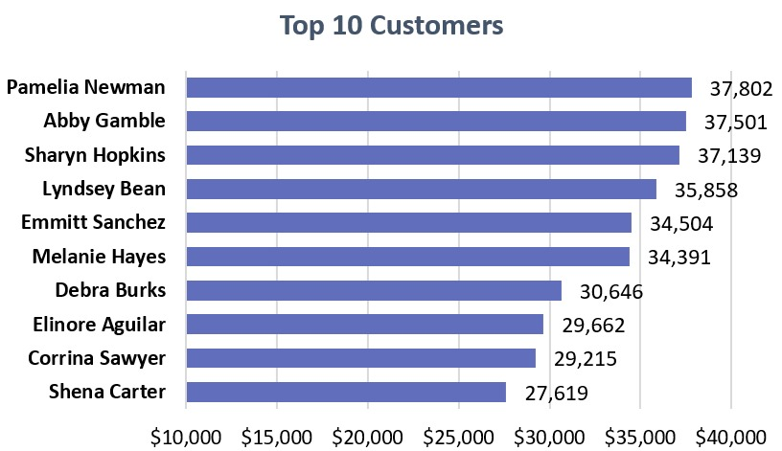
Top 10 Customers
Examining the top 10 customers sheds light on key contributors to Bike Stores' revenue.
Pamelia Newman emerges as the top spender, with purchases totaling $37,802 followed closely by Abby Gamble with $37,501 and Sharyn Hopkins with $37,139.
Notably, each customer's purchases range from $27,619 to $37,802 demonstrating a significant level of engagement and loyalty with Bike Stores.
Understanding the preferences and purchasing behaviors of these top customers is crucial for fostering lasting relationships, implementing targeted marketing strategies, and maximizing customer lifetime value.
By leveraging insights from these top spenders, Bike Stores can tailor their offerings and services to meet their needs effectively, driving continued growth and success in the competitive retail landscape.

Slide 7
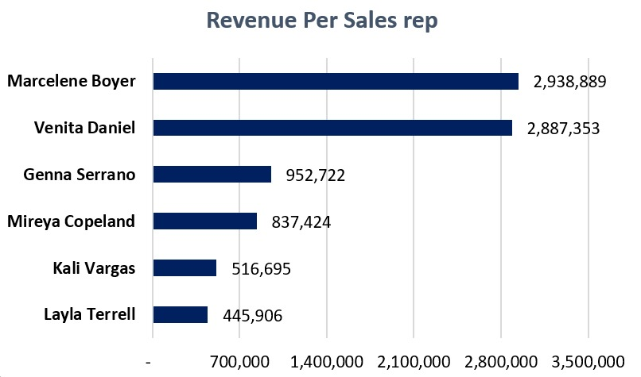
Revenue Per Sales rep
Analyzing revenue per sales representative reveals key contributors to Bike Stores' sales efforts.
Marcelene Boyer emerges as the top performer, generating an impressive $2,938,889 in revenue, closely followed by Venita Daniel with $2,887,353.
Genna Serrano and Mireya Copeland also make significant contributions, with revenues totaling $952,722 and $837,424 respectively.
Additionally, Kali Vargas and Layla Terrell demonstrate commendable sales performance, generating revenues of $516,695 and $445,906 respectively.
This breakdown highlights the diverse contributions of each sales representative to overall revenue generation and underscores the importance of effective sales strategies and relationship-building in driving business success.
Understanding the strengths and performance of each sales representative enables Bike Stores to optimize sales efforts, allocate resources effectively, and foster a culture of excellence within the sales team.

Slide 8
Final Result
After thorough analysis of the data related to Bike Store project, several key insights have emerged. These include:
Revenue Distribution: Revenue is predominantly generated from Mountain Bikes and Road Bikes categories, with significant contributions from Electric Bikes and Cruisers Bicycles.
Geographic Revenue: New York and California are the top revenue-generating states, indicating strong market presence and potential for further growth.
Customer Insights: Top customers such as Pamelia Newman, Abby Gamble, and Sharyn Hopkins contribute significantly to revenue, highlighting the importance of nurturing and retaining high-value customers.
Sales Performance: Sales representatives like Marcelene Boyer and Venita Daniel play a crucial role in driving revenue, showcasing exceptional performance in sales efforts.
Recommendations for Decision Makers:
Product Focus: Invest further in popular categories like Mountain Bikes and Road Bikes to capitalize on existing demand. Additionally, consider expanding the offerings within Electric Bikes and Cruisers Bicycles categories to cater to diverse customer preferences.
Market Expansion: Develop targeted marketing strategies to further penetrate high-revenue states like New York and California. Explore opportunities for opening new stores or strengthening existing presence in these regions.
Customer Engagement: Implement customer loyalty programs, personalized marketing campaigns, and excellent customer service to retain top customers and attract new ones. Focus on building long-term relationships to maximize customer lifetime value.
Sales Team Optimization: Provide training and support to sales representatives to enhance their performance and productivity. Recognize and reward top performers to foster a culture of excellence within the sales team.
By implementing these recommendations, Bike Stores can optimize revenue generation, strengthen market position, and drive sustainable growth in the competitive bicycle retail industry.

